Slide 1

Content Release
By Tatiana Moubray

Slide 2
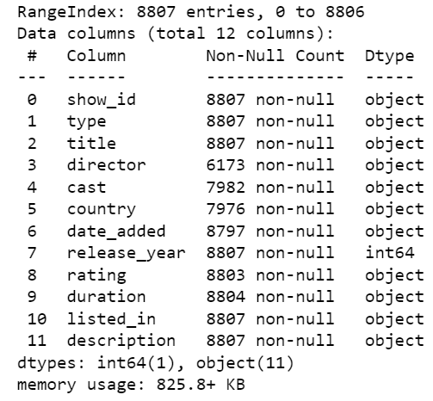
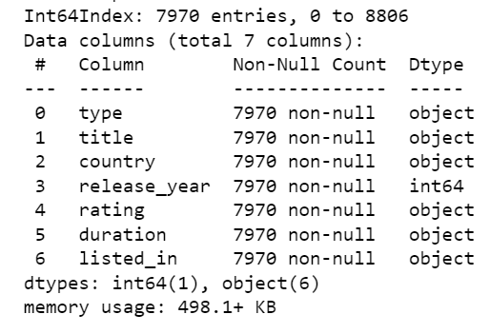
Before Cleaning
After Cleaning

Slide 3
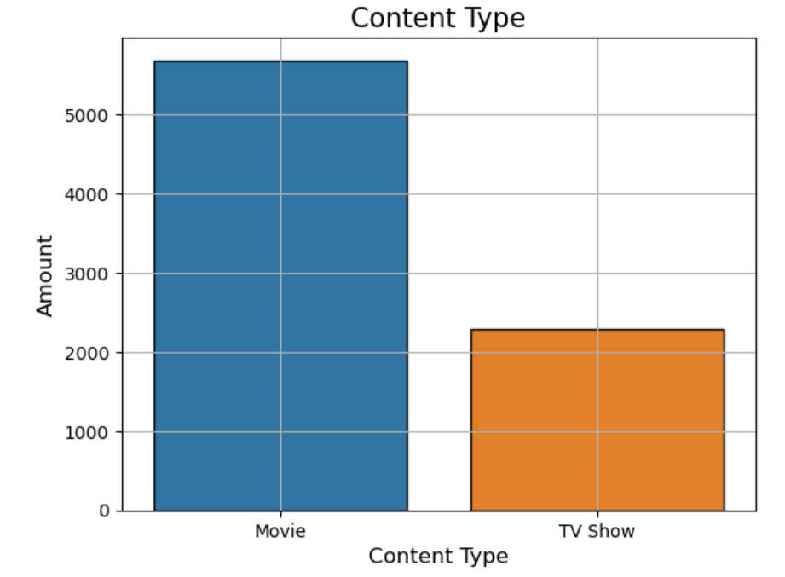
Netflix has produced a significantly larger amount of movies than TV shows.

Slide 4
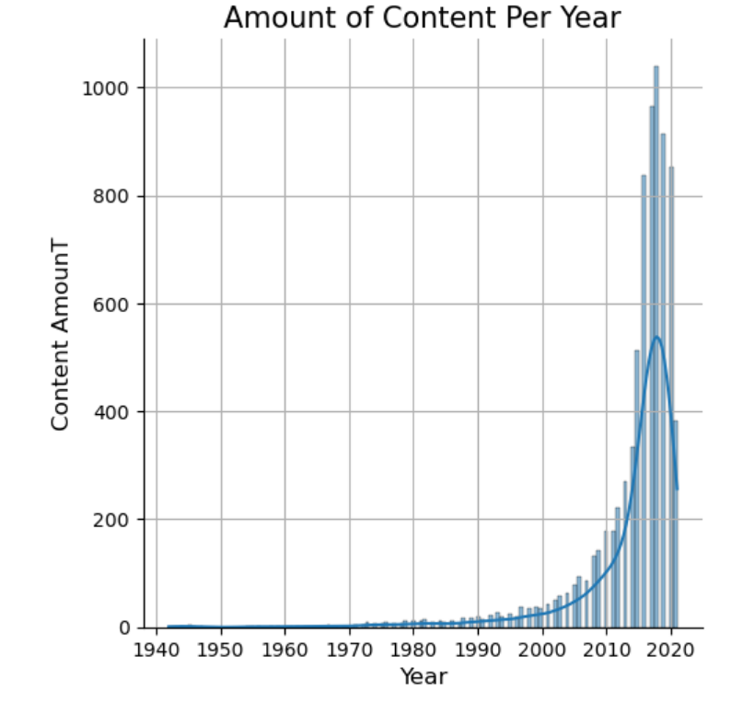
The amount of content Netflix was producing began to increase drastically around 2010, although around 2020 it began to decrease. This is possibly due to the outbreak of COVID-19 and the difficulties that arose.

Slide 5
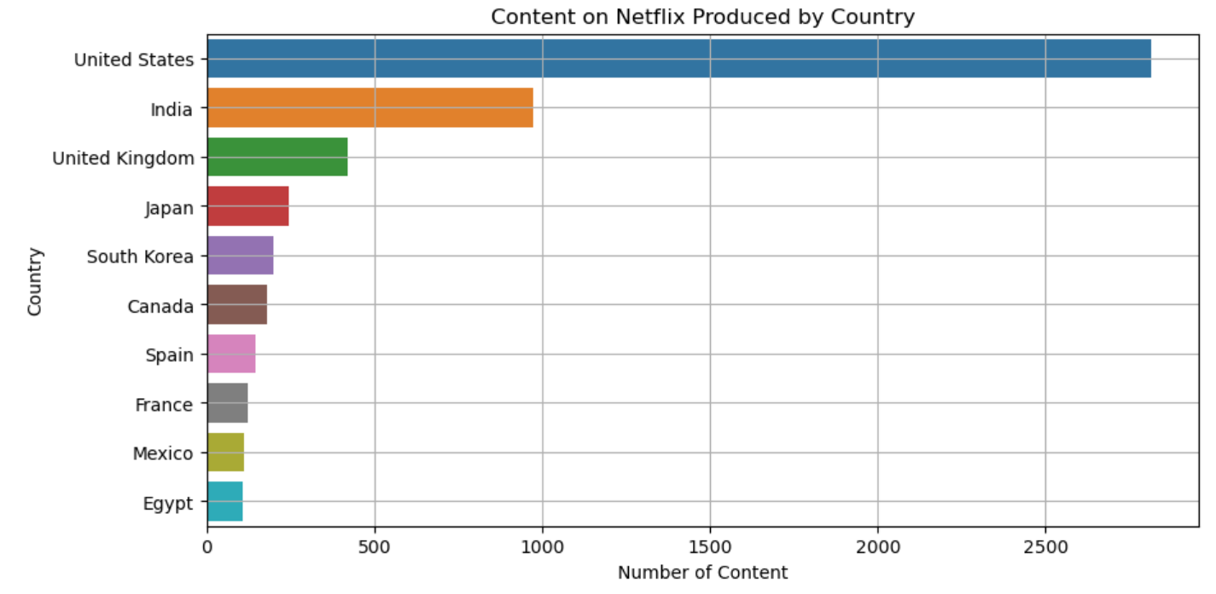
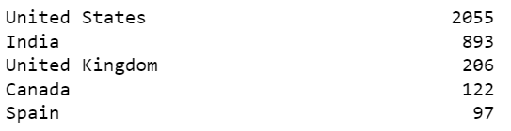

Slide 6
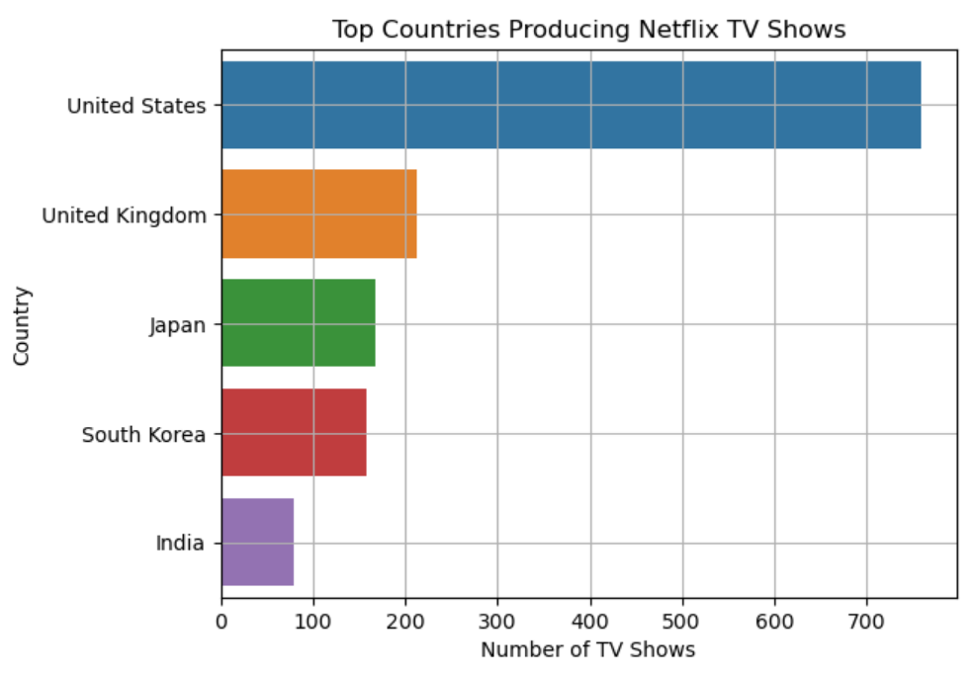

Slide 7
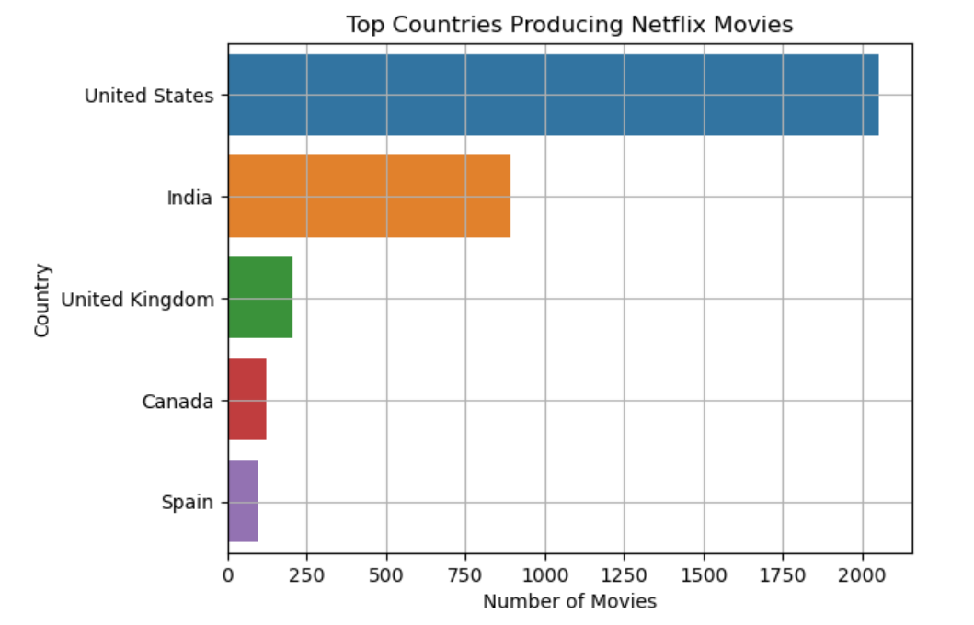

Slide 8
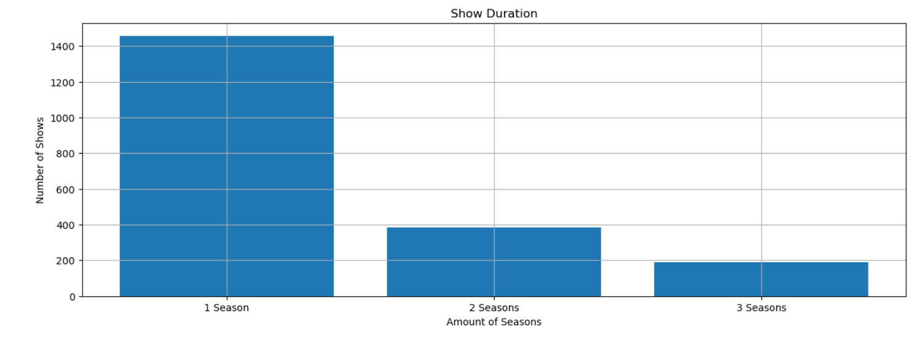

Slide 9
